Slide 1
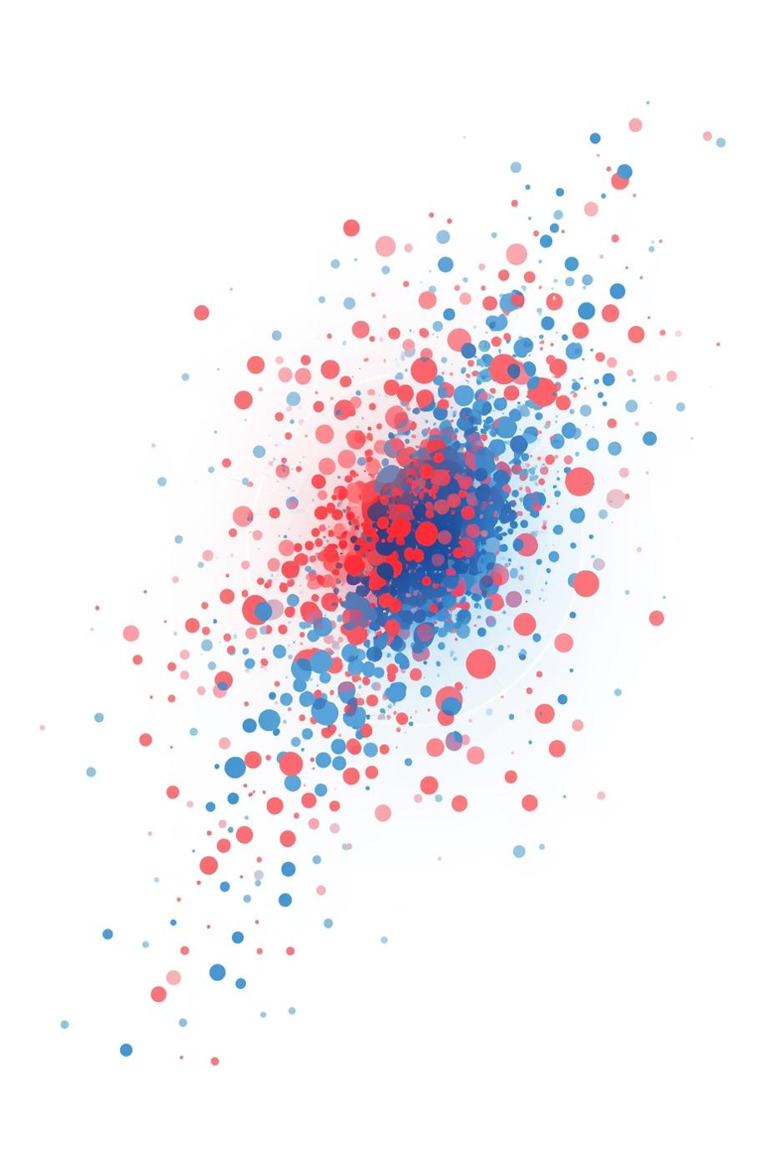
Understanding the Kernel Trick

Slide 2
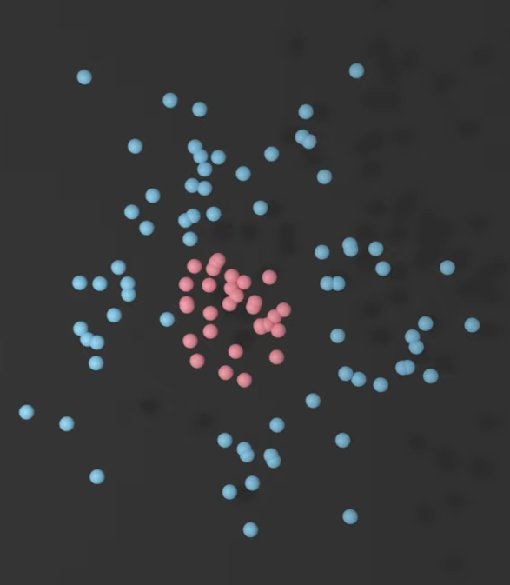
Introduction
So here we have a bunch of red and blue dots, all mixed up so we can’t draw a straight line to separate them. That’s a common problem in machine learning—real-world data is rarely neat and linear. The kernel trick is a clever mathematical shortcut that helps algorithms like Support Vector Machines (SVMs) handle such messy, non-linear data by “lifting” it into a higher-dimensional space where it can be separated easily—without actually doing the heavy lifting!

Slide 3
Concept and Definition
The kernel trick is a technique used in machine learning to solve non-linear problems using linear methods. Instead of trying to draw a curved line in 2D, it imagines the data in 3D (or even higher!) where a flat plane can cleanly split the groups. The magic? It does this without ever calculating the higher-dimensional coordinates—it just computes similarities between data points using a special function called a kernel

Slide 4
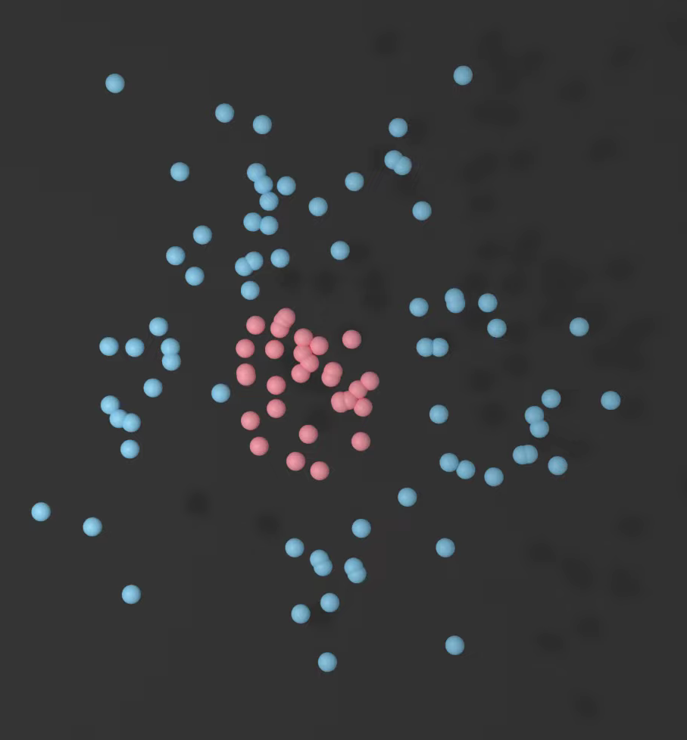
How It Works
  Here we have a dataset with two classes (e.g., red dots and blue dots) that can’t be separated by a straight line in 2D space. This is called non-linearly separable data

Slide 5
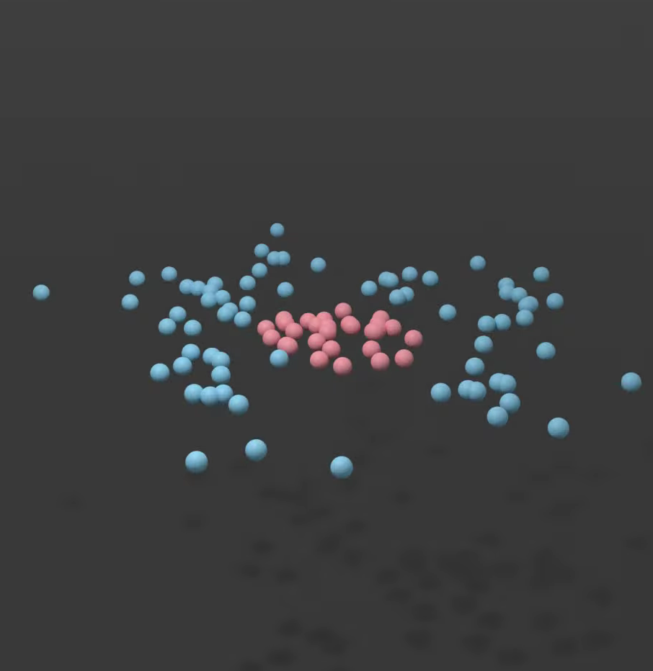
How It Works
  Instead of struggling in 2D, we imagine transforming (mapping) the data into a higher-dimensional space (like 3D or more), where it becomes linearly separable—meaning a flat plane (or hyperplane) can now split the classes cleanly

Slide 6
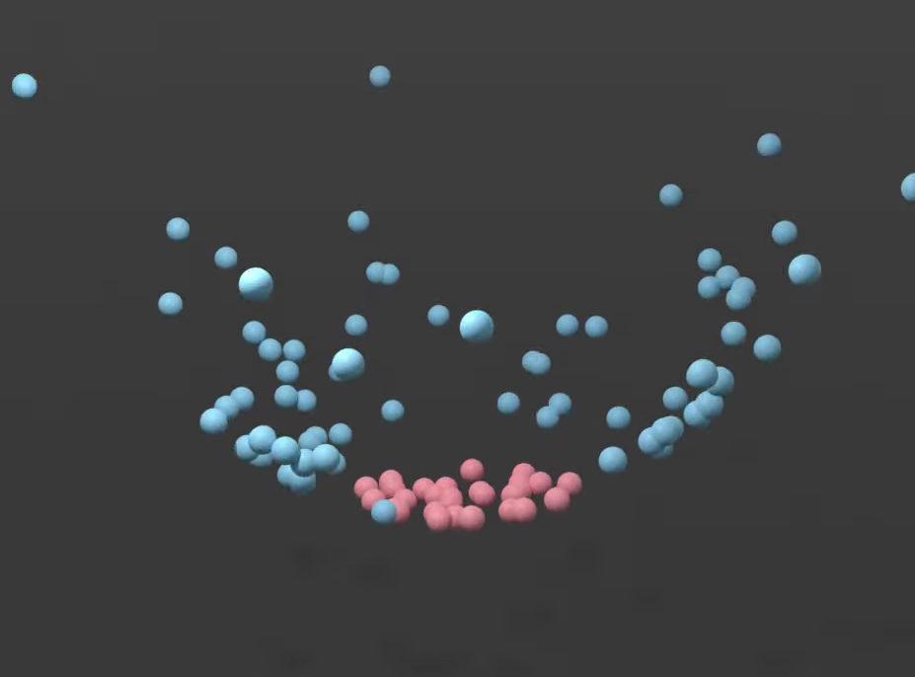
How It Works
  Instead of struggling in 2D, we imagine transforming (mapping) the data into a higher-dimensional space (like 3D or more), where it becomes linearly separable—meaning a flat plane (or hyperplane) can now split the classes cleanly

Slide 7
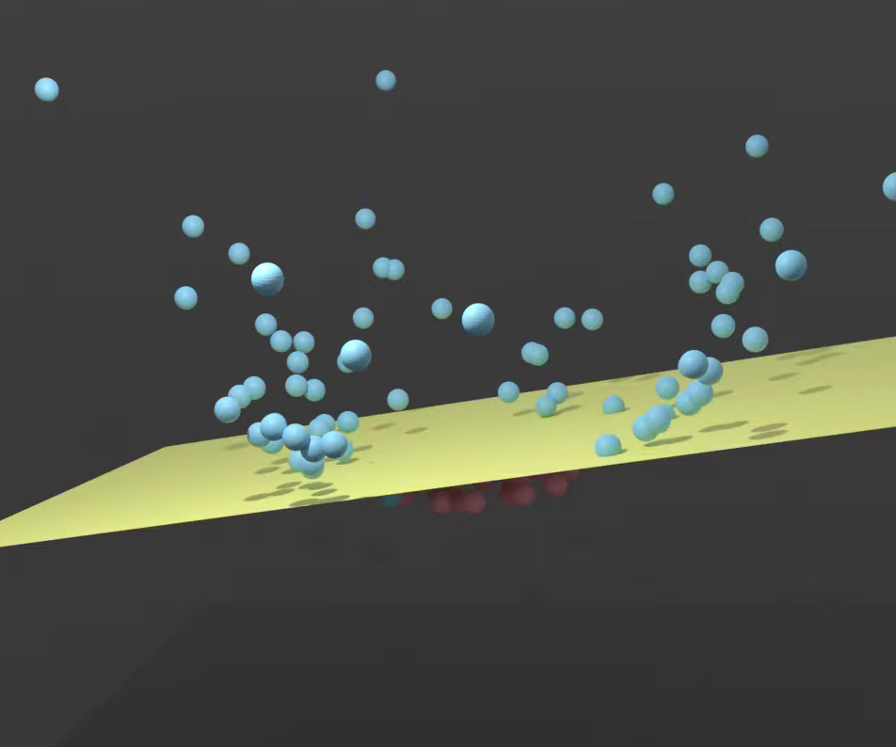
How It Works
  Instead of struggling in 2D, we imagine transforming (mapping) the data into a higher-dimensional space (like 3D or more), where it becomes linearly separable—meaning a flat plane (or hyperplane) can now split the classes cleanly

Slide 8
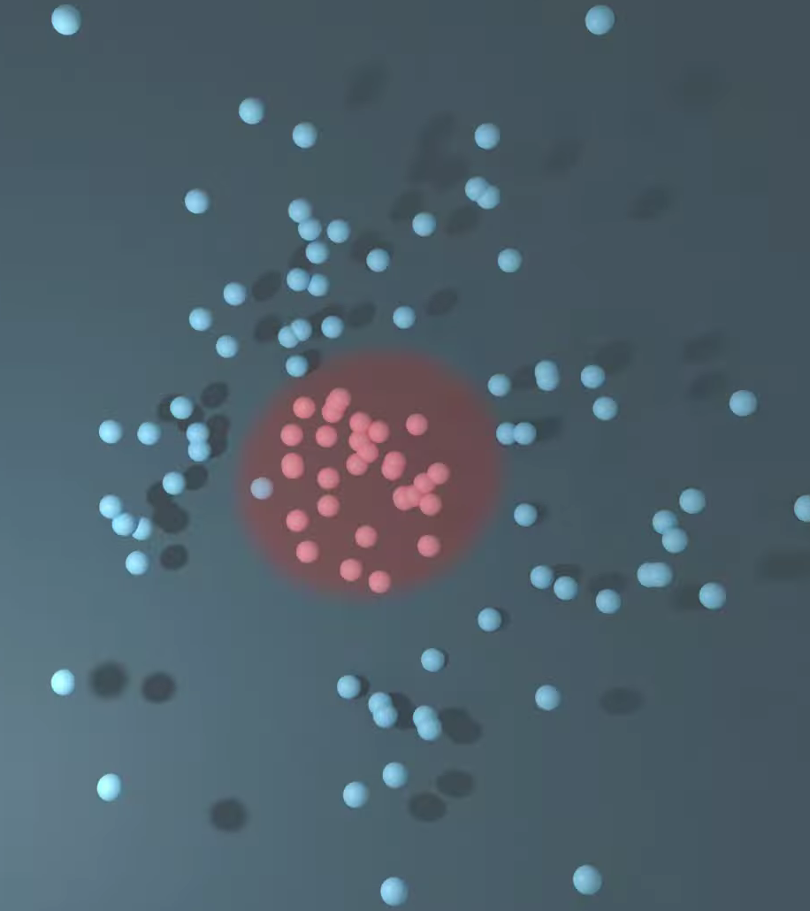
How It Works
  Instead of explicitly mapping each point to higher dimensions, the kernel trick uses a kernel function to compute the similarity (dot product) between two points as if they were already in that higher-dimensional space—without ever calculating the coordinates

Slide 9
How It Works
  Algorithms like Support Vector Machines (SVM) only need dot products to find the best decision boundary. By plugging in a kernel (e.g., RBF or Polynomial), the SVM behaves as if it’s working in high-dimensional space, but runs efficiently in the original space

Slide 10
Examples (Real-World Applications)
1. Text Classification (Sentiment Analysis)
In social media monitoring, companies use SVMs with kernel tricks to classify tweets or reviews as positive, negative, or neutral—even though words don’t form neat lines in data space.
2. Image Recognition
Facial recognition systems use kernel-based SVMs to distinguish faces from backgrounds or identify individuals, especially when lighting or angles create non-linear variations

Slide 11
A Comprehensive Overview of the Applications of Kernel Functions and Data-driven Models in Regression and Classification Tasks in the Context of Software Sensors
It explains how kernel functions enable data-driven models—like Support Vector Machines (SVM) and Kernel Partial Least Squares Regression (KPLSR) to handle nonlinear data by implicitly mapping it into a higher-dimensional space where it becomes linearly separable. The paper emphasizes that the Gaussian (RBF) kernel is the most widely used due to its strong performance in real-world applications like wastewater treatment, medical diagnosis, and industrial soft sensors. It highlights that most research focuses on classification, while regression tasks using kernels are underexplored.

Slide 12
A Comprehensive Overview of the Applications of Kernel Functions and Data-driven Models in Regression and Classification Tasks in the Context of Software Sensors
The authors note that kernel methods are especially valuable in soft sensor technology, where they replace costly hardware sensors by predicting hard-to-measure variables from easy-to-collect data. The review also compares different kernel types such as polynomial, sigmoid, and RBF discussing their strengths, weaknesses, and suitability for specific problems. Finally, it recommends combining adaptive (self-updating) models with diverse kernel functions to improve accuracy in dynamic industrial environments.

Slide 13
Reflection
In today’s world of big, messy data (from medical scans to customer reviews), we need tools that are both powerful and efficient. The kernel trick lets us use robust linear algorithms on non-linear problems without massive computational cost, making it essential for real-world AI systems—even as deep learning rises, kernel methods continue to underpin many hybrid and interpretable models.

